Slide 1
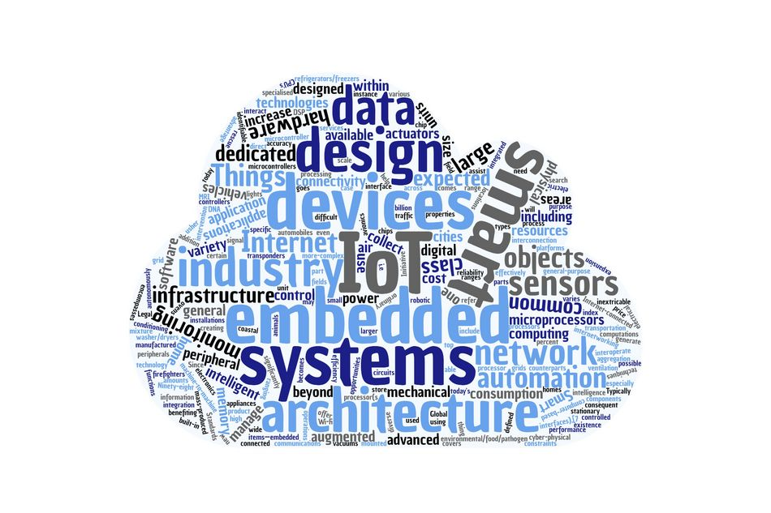
Runtime Deployment, Management and Monitoring of Web of Things Systems
Miguel Romero Karam miguel.romero@tum.de Embedded Systems and Internet of Things Department of Electrical and Computer Engineering
Munich | December 14, 2020

Slide 2
Introduction
Approach
Evaluation
Conclusion
Notes:
We will start with a brief introduction, continue with the developed approach followed by the evaluation, to finally close with the conlusion

Slide 3
Introduction
Motivation
WoT Thing Description
WoT System Description
Problem Statement
Approach
Evaluation
Conclusion

Slide 4
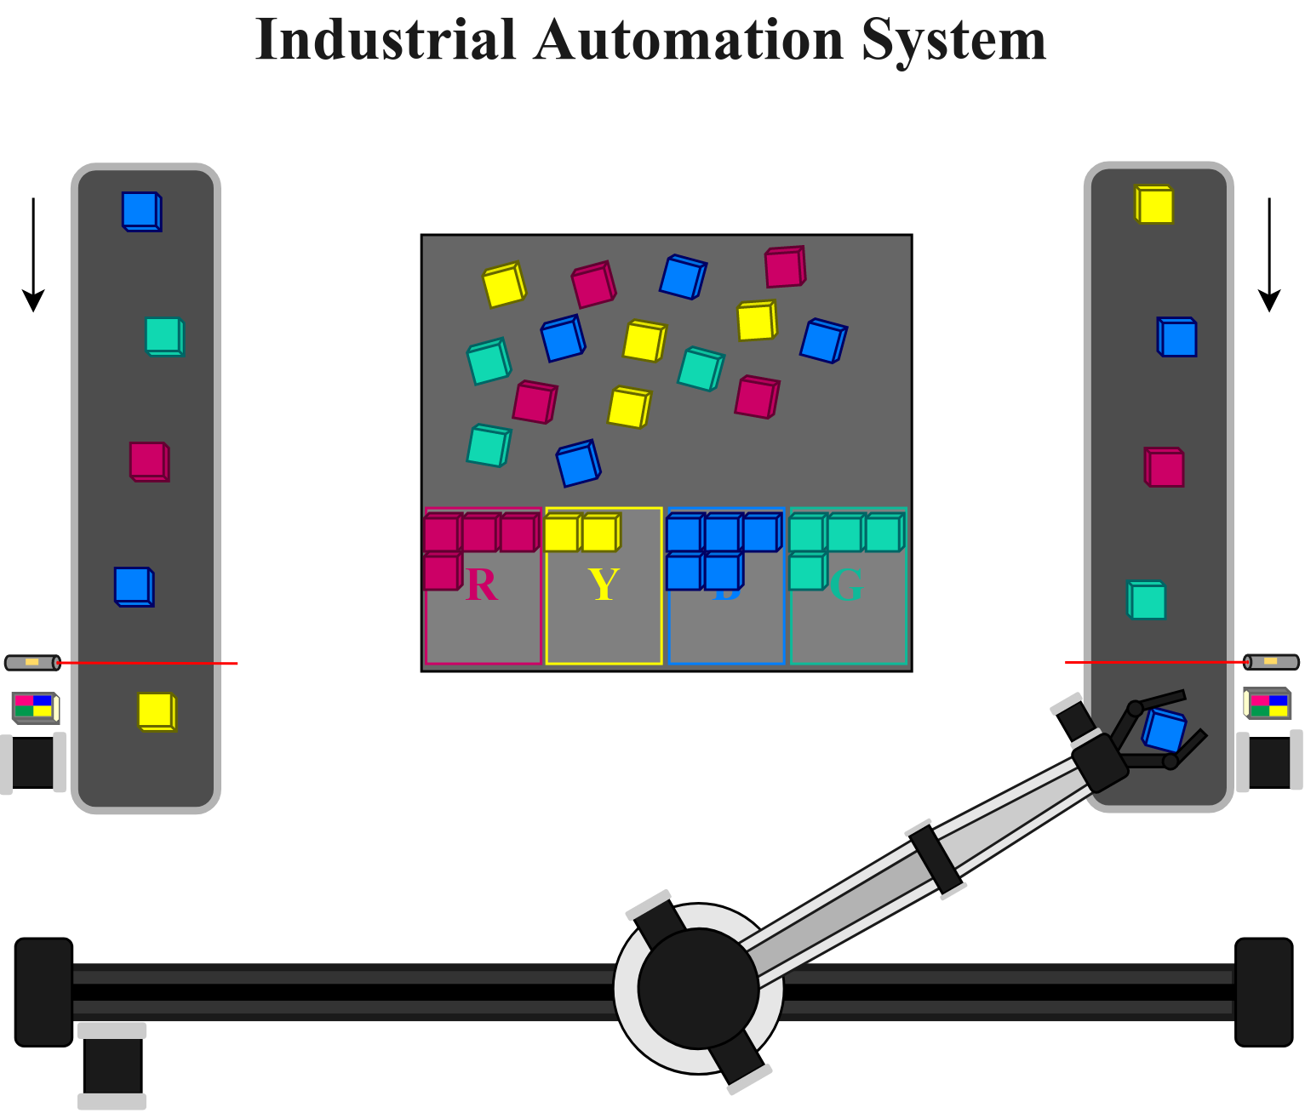
Introduction Motivation
Notes:
Consider an industrial automation scenario like the one above, consisting of …

Slide 5

Introduction Motivation
Notes:
Consider an industrial automation scenario like the one above, consisting of …

Slide 6

Introduction Motivation
Notes:
Consider an industrial automation scenario like the one above, consisting of …

Slide 7

Introduction Motivation
Notes:
Consider an industrial automation scenario like the one above, consisting of …

Slide 8

Introduction Motivation
Notes:
Infrared sensors on each conveyor belt to detect the position of blocks in the belt

Slide 9

Introduction Motivation
Notes:
And color sensors to detect their color

Slide 10
Introduction Motivation
Notes:
We now have what we consider a System, composed of multiple standalone Things.
How can we go about programming the interactions between multiple standalone Things?

Slide 11

Introduction Motivation
Notes:
Well, the Web of Things, an open standard of the W3C foundation provides the Thing Description format for description of Things, independent of their protocols and data models
The TD provides a static and serializable description format for describing simple Things, like this color sensor.

Slide 12
Introduction Motivation
Notes:
And more complex Things, like this Robot Arm with multiple degrees of freedom, mounted on a sliding rail

Slide 13
Introduction Motivation
Notes:
Or this conveyor belt, consisting of multiple sensors and actuators

Slide 14
Introduction
Motivation
WoT Thing Description
WoT System Description
Problem Statement
Approach
Evaluation
Conclusion
Notes:
So, what exactly is the Thing Description standard? Lets consider an example...

Slide 15
Introduction WoT Thing Description
Notes:
Zooming out a bit, we consider the conveyor belt on the left

Slide 16

Introduction WoT Thing Description
Notes:
A TD to describe the possible interactions of this belt, could maybe look like...

Slide 17
Introduction WoT Thing Description
TD of Conveyor Belt
"name": "LeftConveyorBelt",
"@type": "conveyor-belt",
"properties": [
"speed": {
"type": "number", "minimum": -100.0,
"maximum": 100.0
},
"status": {{
"type": "string", "enum": [ "on", "off" ],
}
],
"actions: [
"start": {...},
"stop": {...},
],
"events: [
"emergencystop": {...},
],
"security": [...]
Notes:
...this
Here you can see how a TD allows describing the metadata of the conveyor belt such as the name, and semantic @type annotations
To enlist properties, such as speed of number type with max and min and status, with 2 possible value, either on or off,
the actions, such as the start and stop commands,
and events, such as the emergencystop event which fires on the press of the emergency button
We can see how the TD provides a powerful description Model for Things, but what about systems of Things?

Slide 18
Introduction
Motivation
WoT Thing Description
WoT System Description
Problem Statement
Approach
Evaluation
Conclusion
Notes:
We’ve seen how Thing descriptions help to model things. The System Description introduces a means to model systems of things.
Lets consider the previous example: an industrial automation system

Slide 19
Introduction WoT System Description
Notes:
We now consider the entire system...

Slide 20
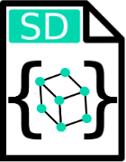
Introduction WoT System Description
Notes:
Analogously to how the TD allows describing Things, the SD permits describing Systems and their application logic
This SD extends the TD format with additional keywords, keeping it fully TD-compliant
We won’t go into the details of the SD now, but you can take my word that an SD looks very similar to a TD

Slide 21
Introduction
Motivation
WoT Thing Description
WoT System Description
Problem Statement
Approach
Evaluation
Conclusion

Slide 22


Introduction Problem Statement
Thing Description
Allows modelling simple and complex standalone Things
Notes:
So… we have seen that the Thing Description readily enables modeling both simple and complex standalone Things

Slide 23

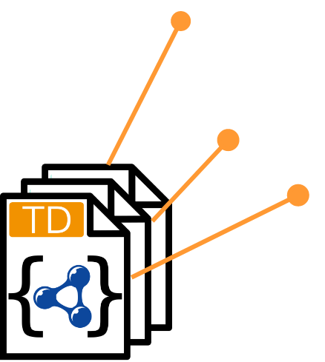
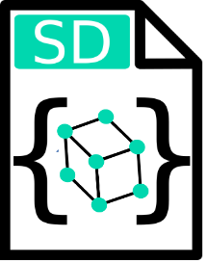
Introduction Problem Statement
System Description
Thing Description
Allows describing interaction logic between Things, in order to create WoT Systems
Allows modelling simple and complex standalone Things
Notes:
The SD in turn allows interconnecting those Things in order to create WoT Systems
to perform automated procedures and tasks that solve real-world problems

Slide 24

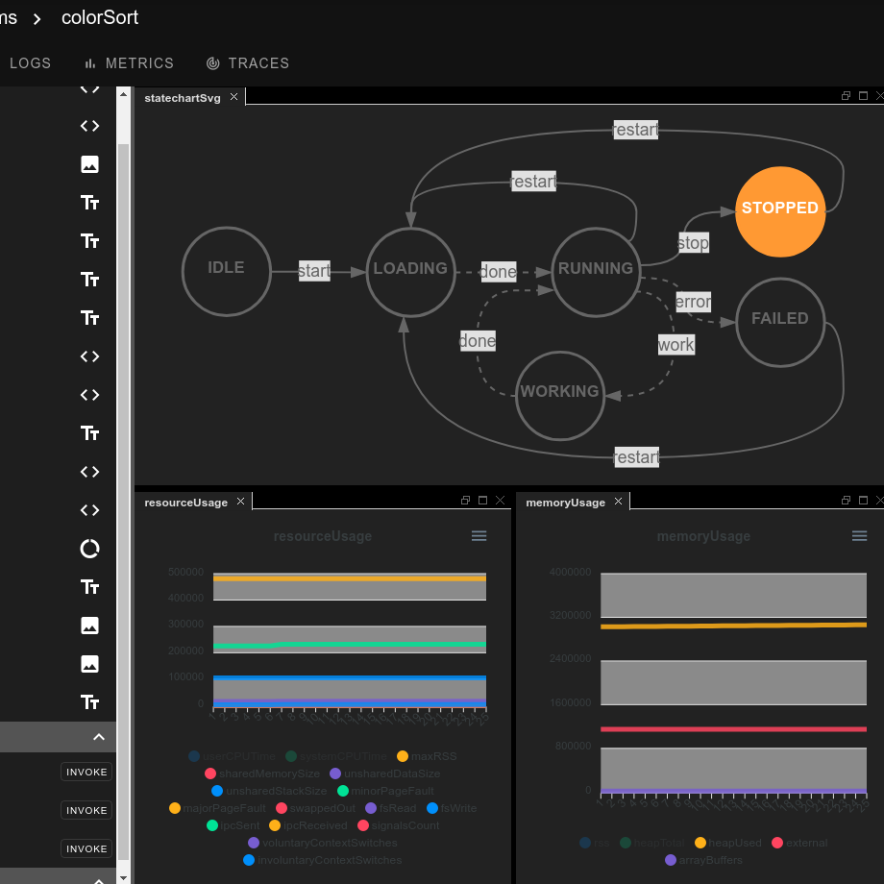
Introduction Problem Statement
Development Tools
System Description
Thing Description
For deployment, management, and monitoring of WoT Systems
Allows describing interaction logic between Things, in order to create WoT Systems
Allows modelling simple and complex standalone Things
Notes:
What is actually missing is a systematic approach that facilitates the development cycle of such WoT.
More specifically, development tools for the deployment, management and monitoring of WoT Systems are needed.
Such tools would increase WoT adoption, which is at the moment still relatively low

Slide 25
Introduction
Approach
Overview
Methodology
Execution Environment and Control
WoT Runtime UI
Evaluation
Conclusion

Slide 26
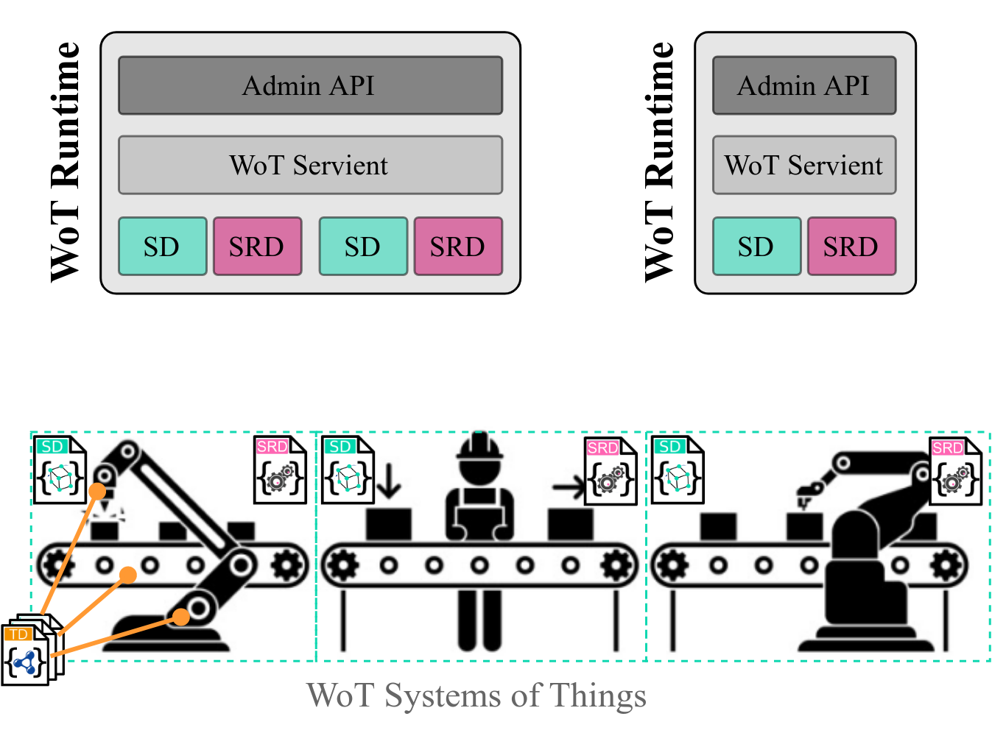
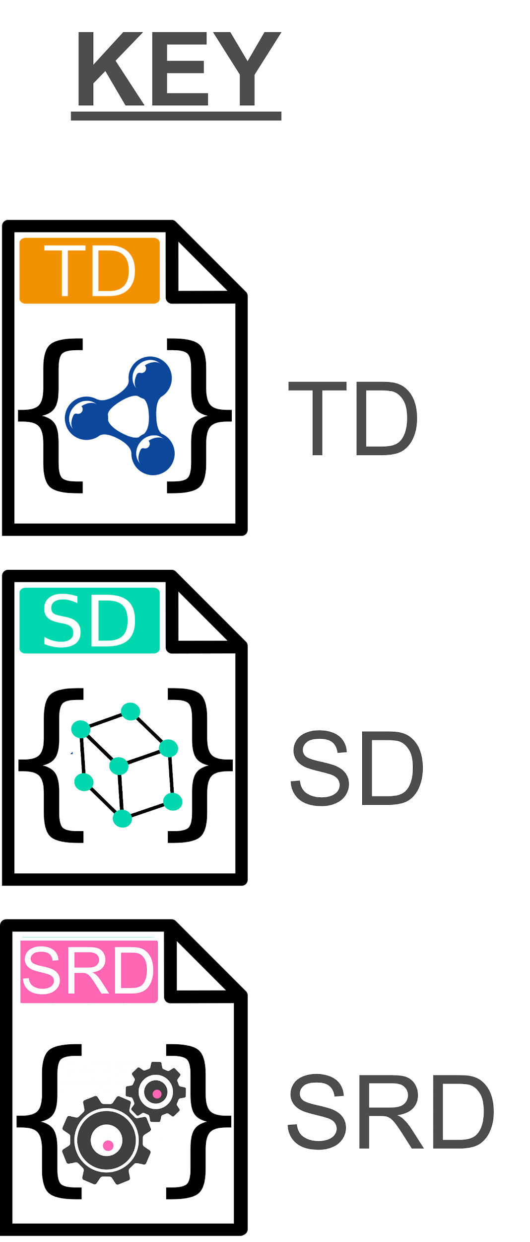
Approach Overview
Notes:
This thesis introduces the modular and extensible WoT Runtime Framework to run on remote hosts above the WoT System layer, down below
Each instance of the WoT Runtime Framework is composed of:
a network-facing Admin API
an internal WoT Servient
and any number of SDs (in green)
and unique SRDs for each running System (in pink)

Slide 27
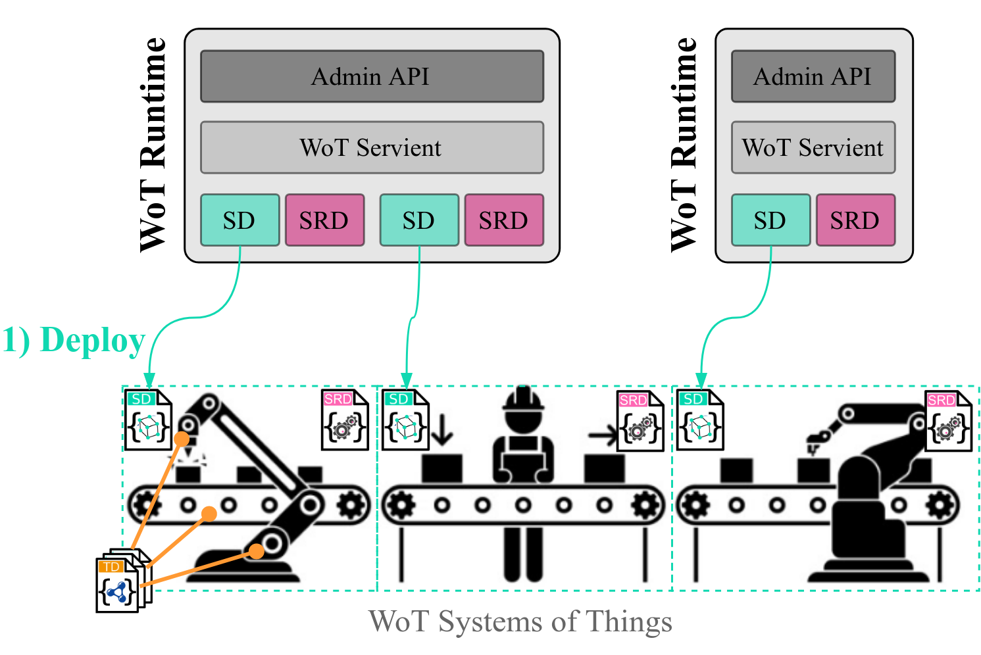
Approach Overview
Notes:
The modular framework remains decoupled from the underlying WoT System infrastructure and allows:
remote deployment of SD into execution

Slide 28
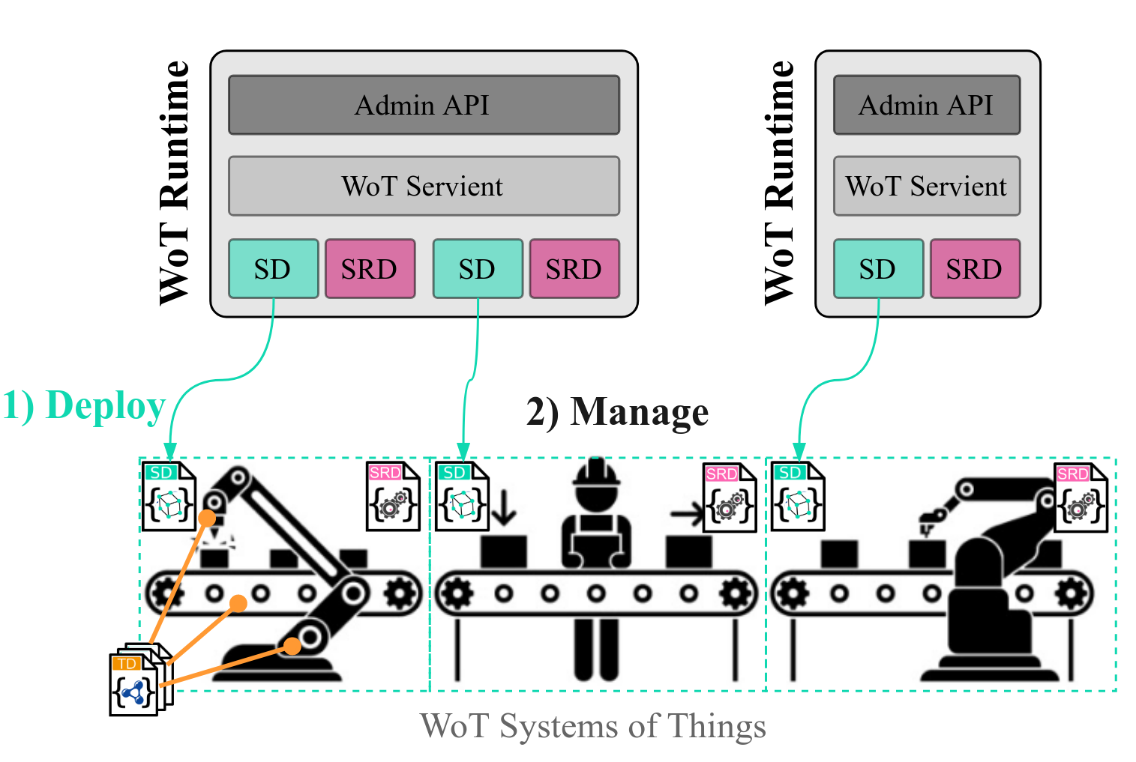
Approach Overview
Notes:
management of WoT System Runtimes through their lifecycle

Slide 29
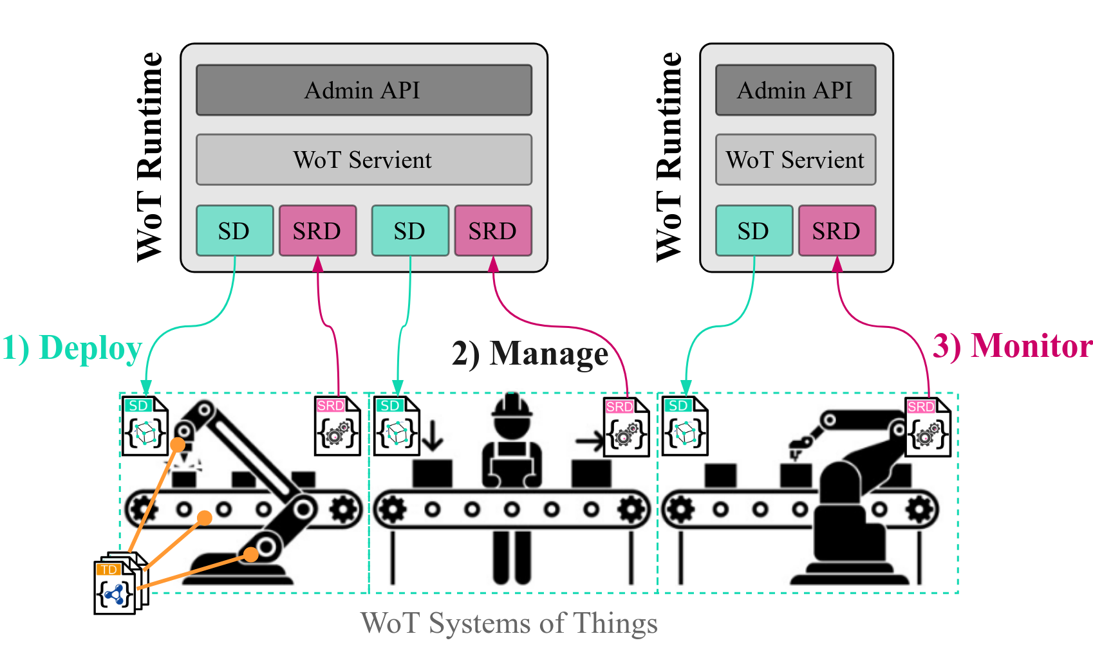
Approach Overview
Notes:
and monitoring and control through the consumption of the auto-generated SRD for each WoT system runtime

Slide 30
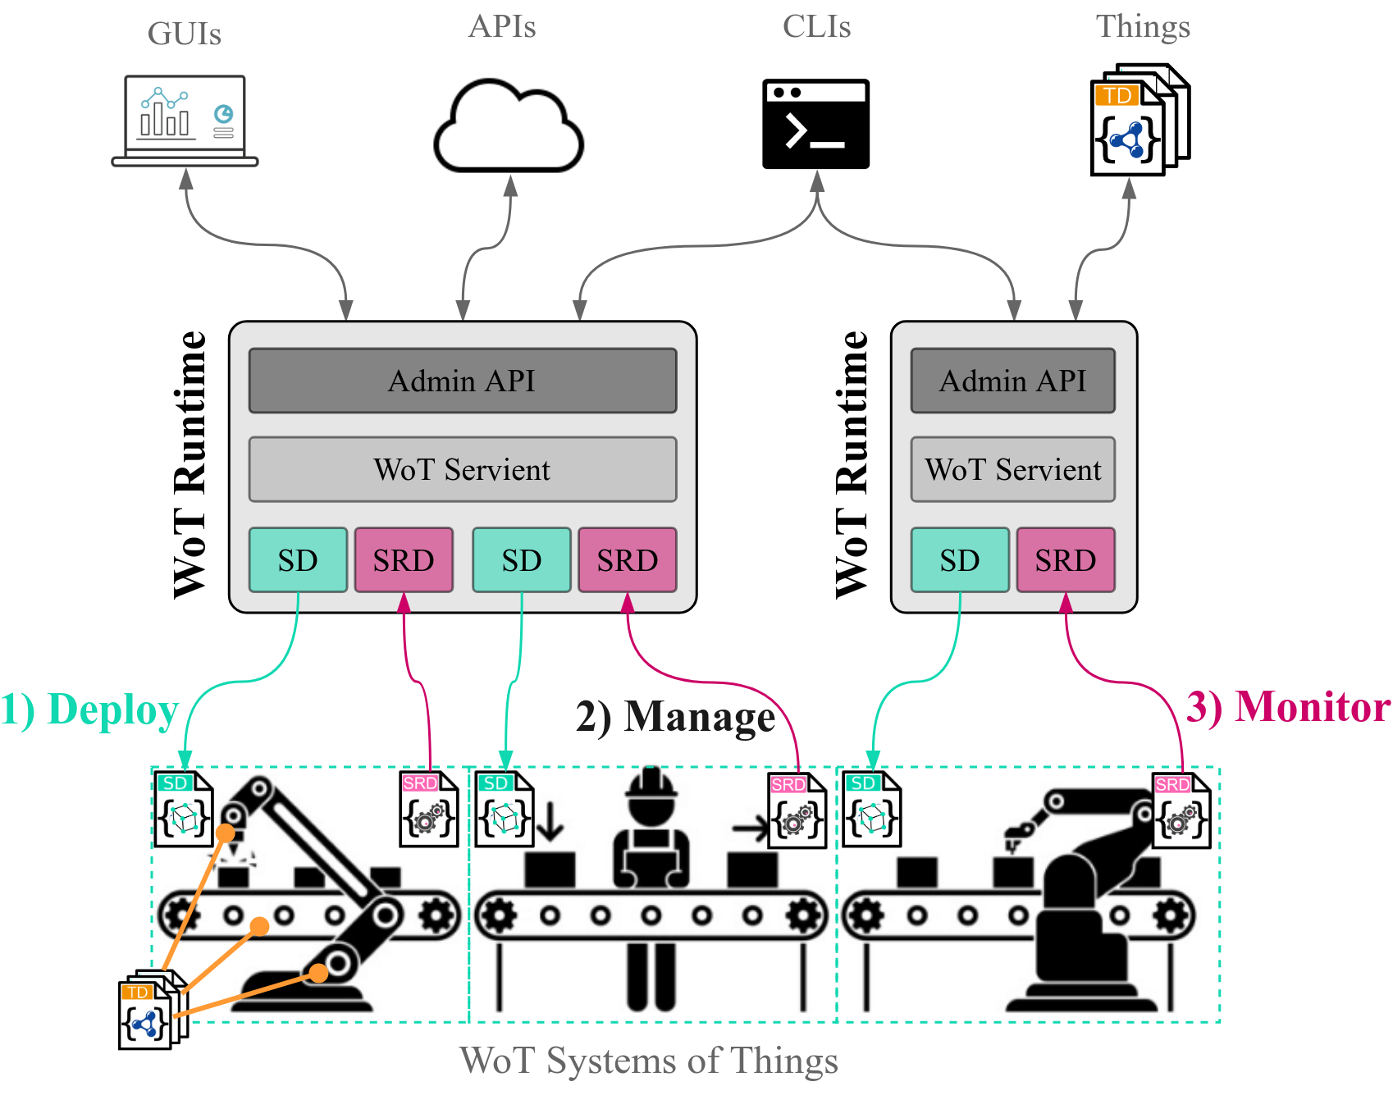
Approach Overview
Notes:
As shown above, the WoT Runtime can be consumed by arbitrary client types, such as GUIs, APIs, CLIs as well as other WoT Things
making it possible to compose multi-layered, distributed WoT architectures

Slide 31
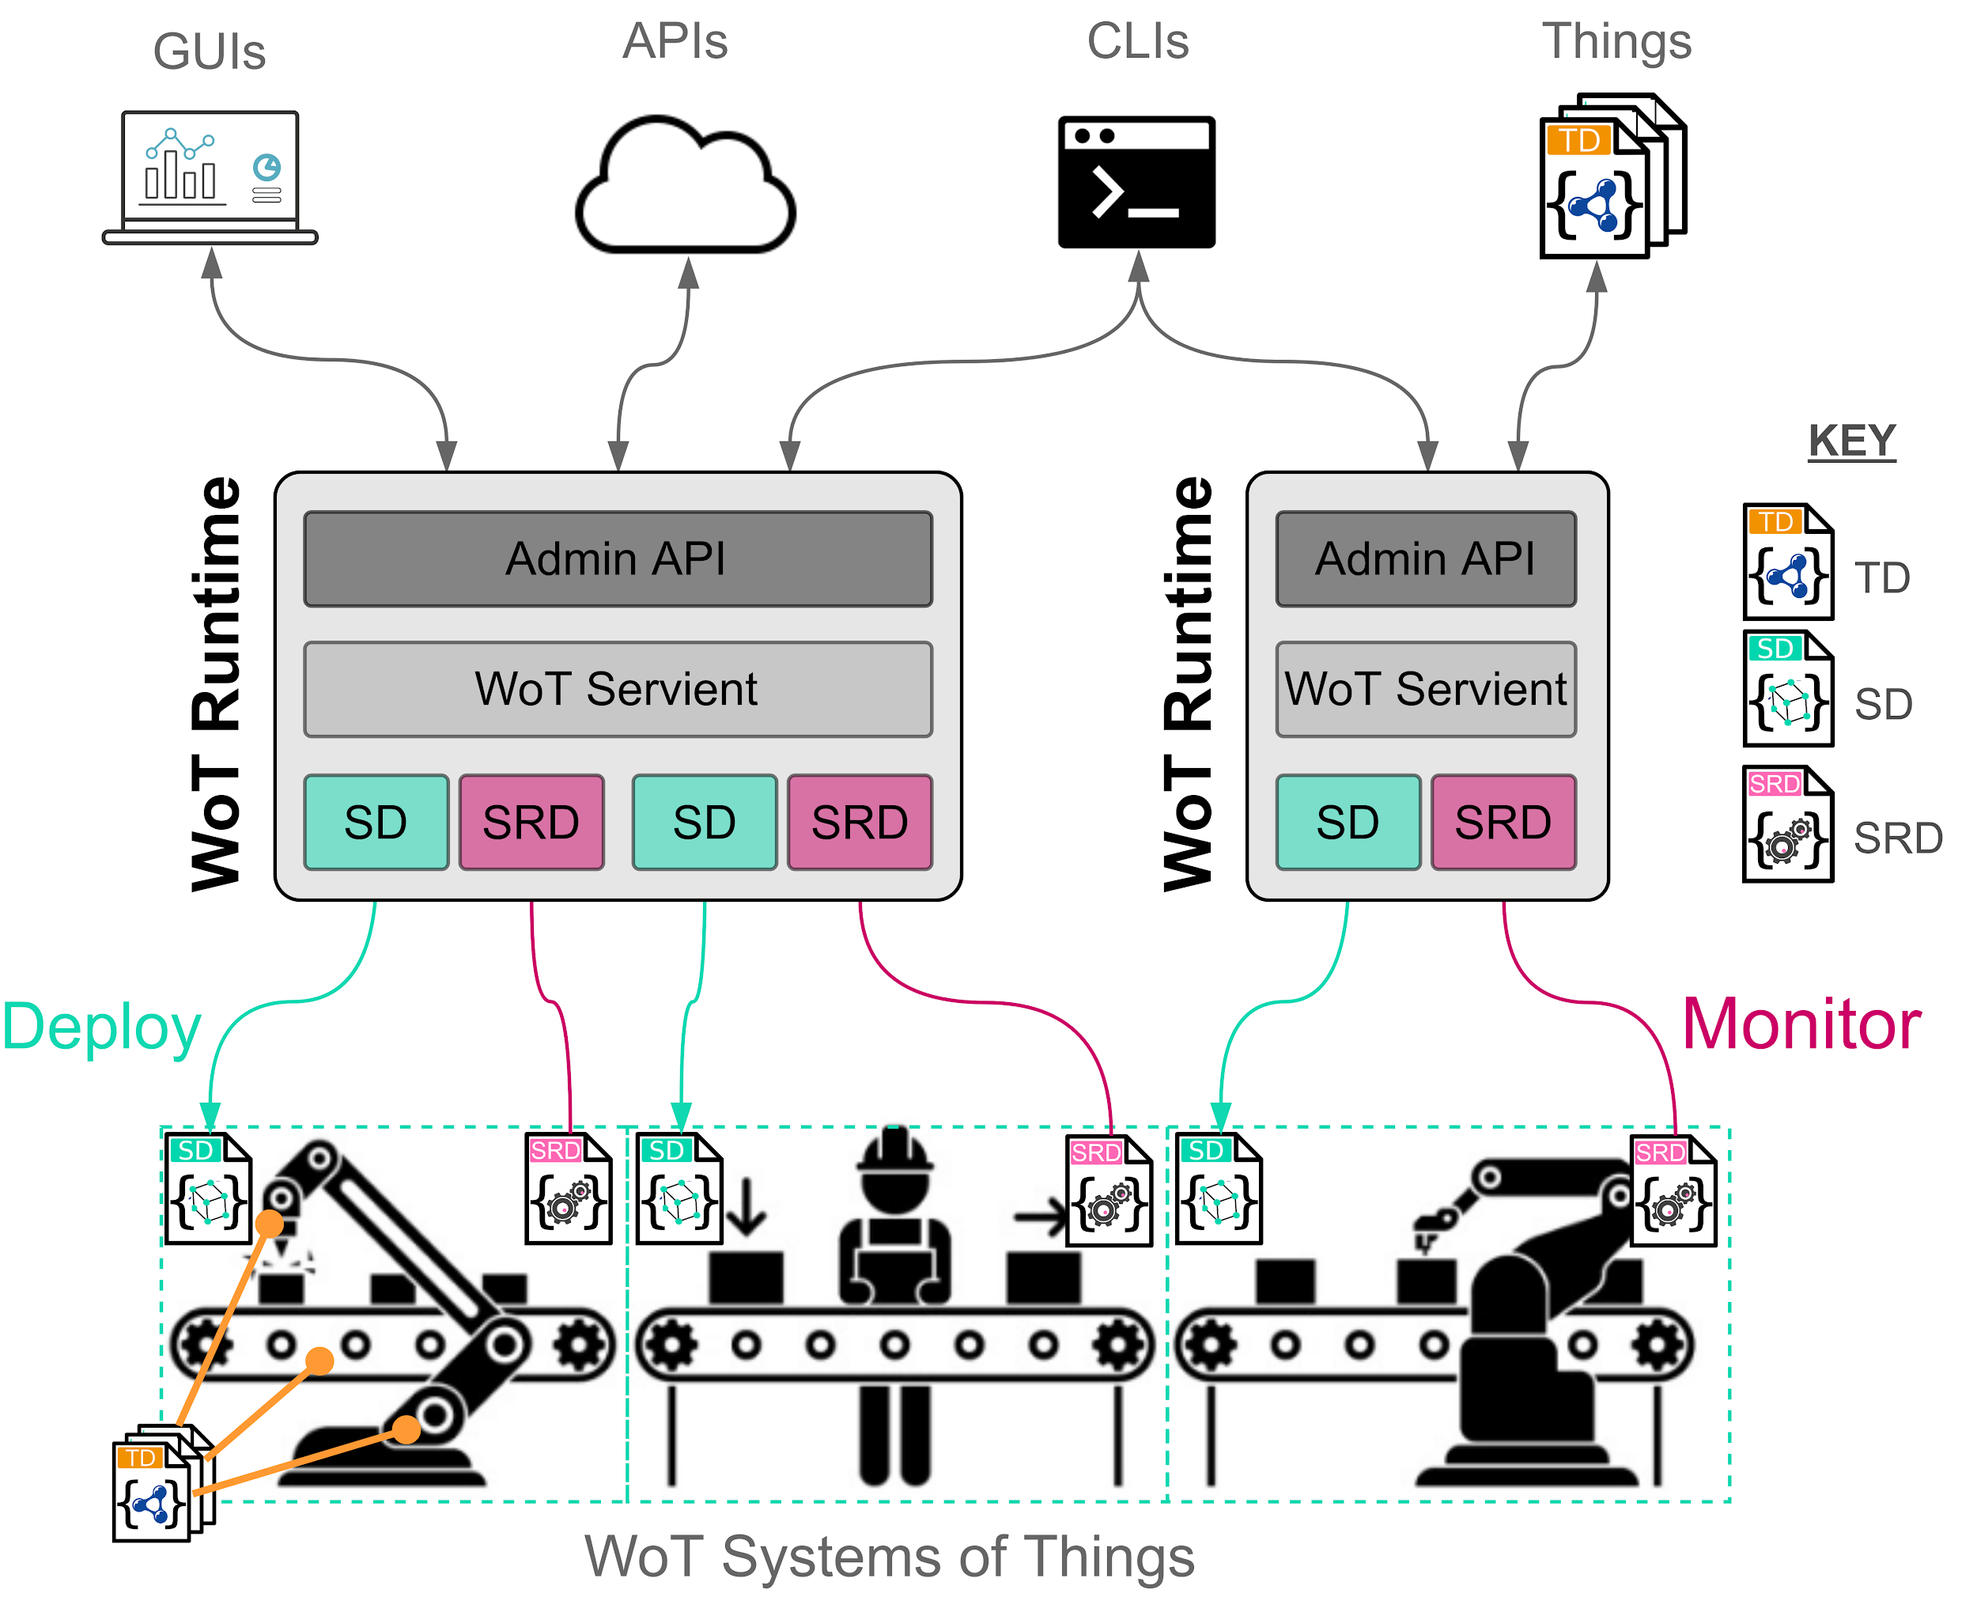
Approach Overview

Slide 32
Introduction
Approach
Overview
Methodology
Execution Environment and Control
WoT Runtime UI
Evaluation
Conclusion
Notes:
We now continue with the proposed methdology

Slide 33
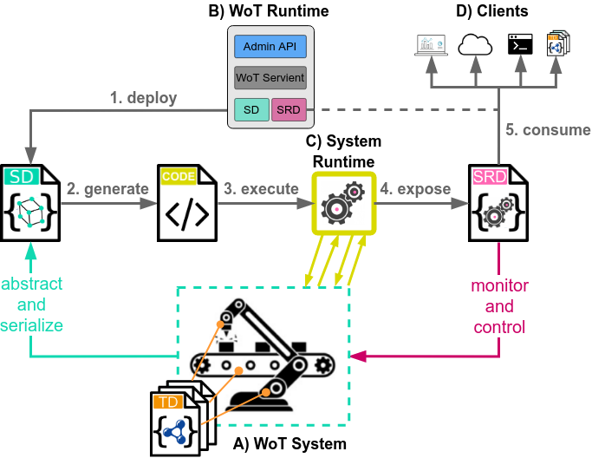
Approach Methodology
Notes:
Here you can see an overview of the methodology...

Slide 34
Approach Methodology
Notes:
Below you see a Wot system consisting of several Things, described by their TDs, which is abstracted and serialized by a SD

Slide 35
Approach Methodology
Notes:
Above you can see a running instance of the remote WoT runtime framework

Slide 36
Approach Methodology
Notes:
The system runtime, responsible for execution of WoT application logic

Slide 37
Approach Methodology
Notes:
And finally, several example clients which directly consume the SRD for monitoring and control of the system

Slide 38
Approach Methodology
Notes:
The approach is divided in 5 main steps.
deploy

Slide 39
Approach Methodology
Notes:
2) generate

Slide 40
Approach Methodology
Notes:
3) execute

Slide 41
Approach Methodology
Notes:
4) expose

Slide 42
Approach Methodology
Notes:
5) consume

Slide 43
Introduction
Approach
Overview
Methodology
Execution Environment and Control
Execution Control
Evaluation
Conclusion

Slide 44
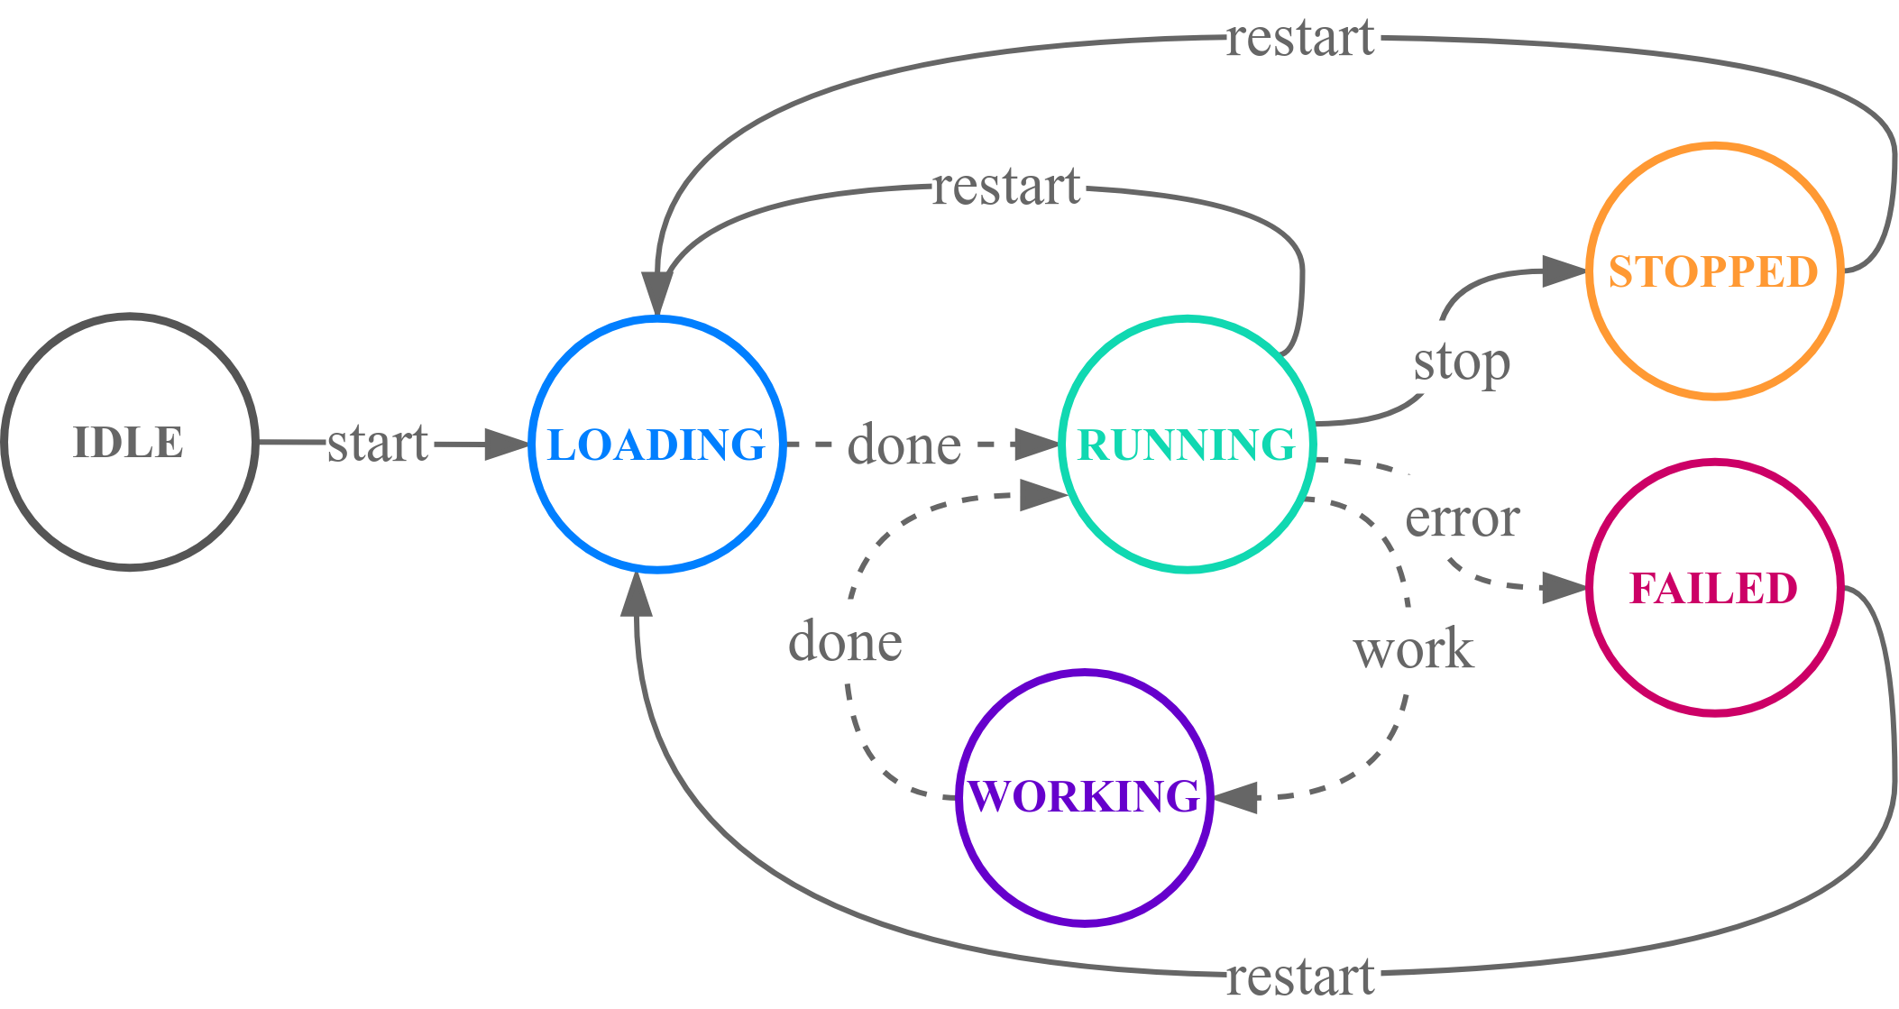
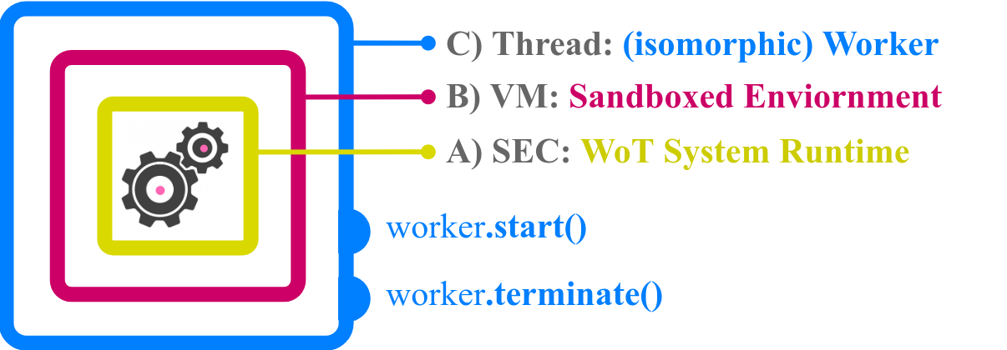
Approach Execution Environment and Control

Slide 45
Introduction
Approach
Overview
Methodology
Execution Environment and Control
WoT Runtime UI
Evaluation
Conclusion

Slide 46
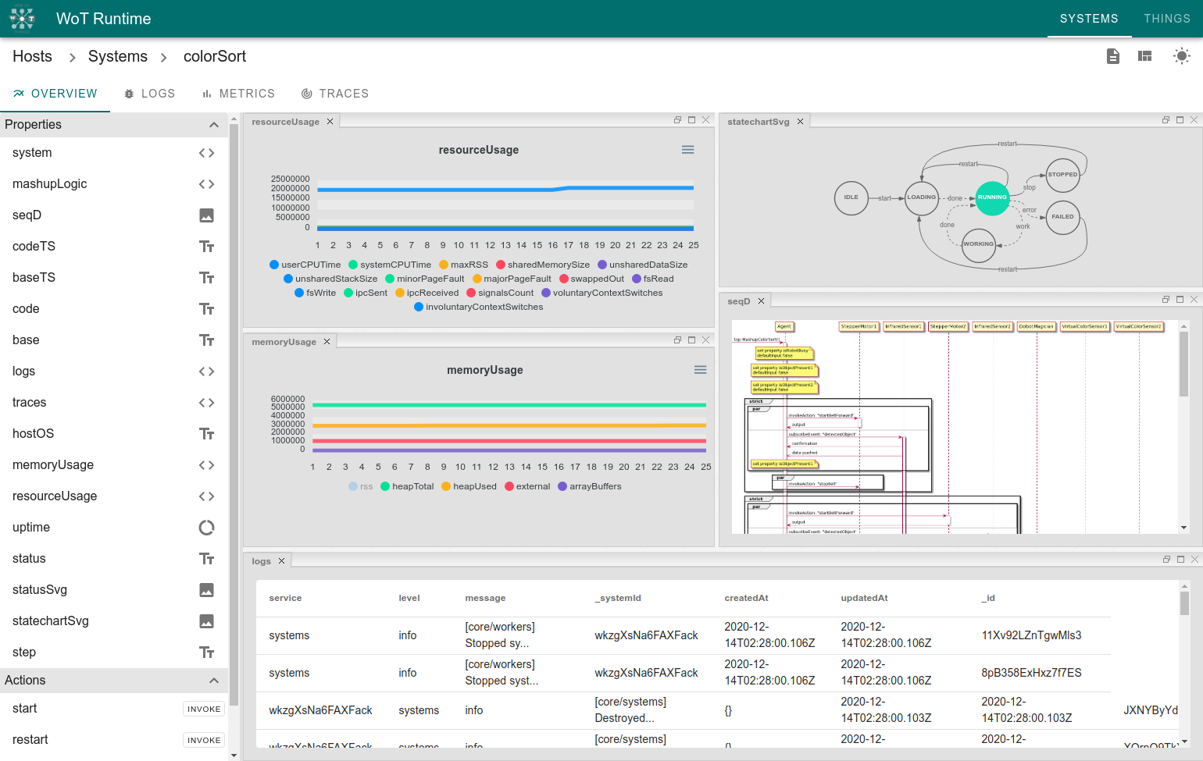
Approach WoT Runtime UI - System Dashboard

Slide 47
Approach WoT Runtime UI - System Dashboard (dark)

Slide 48
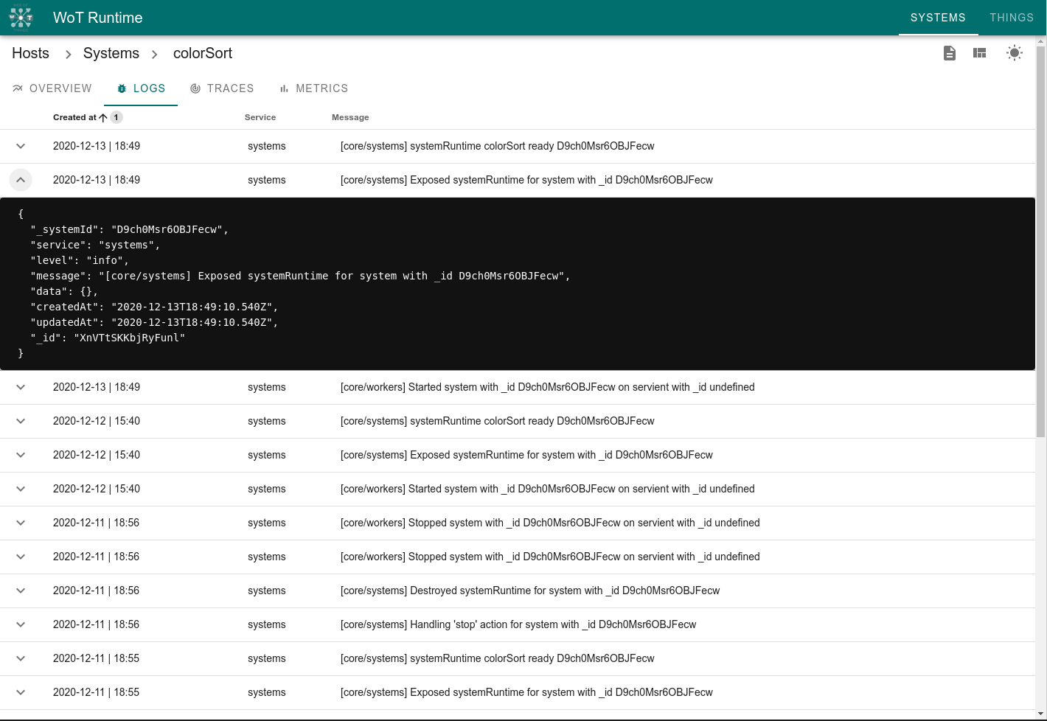
Approach WoT Runtime UI - Logs

Slide 49
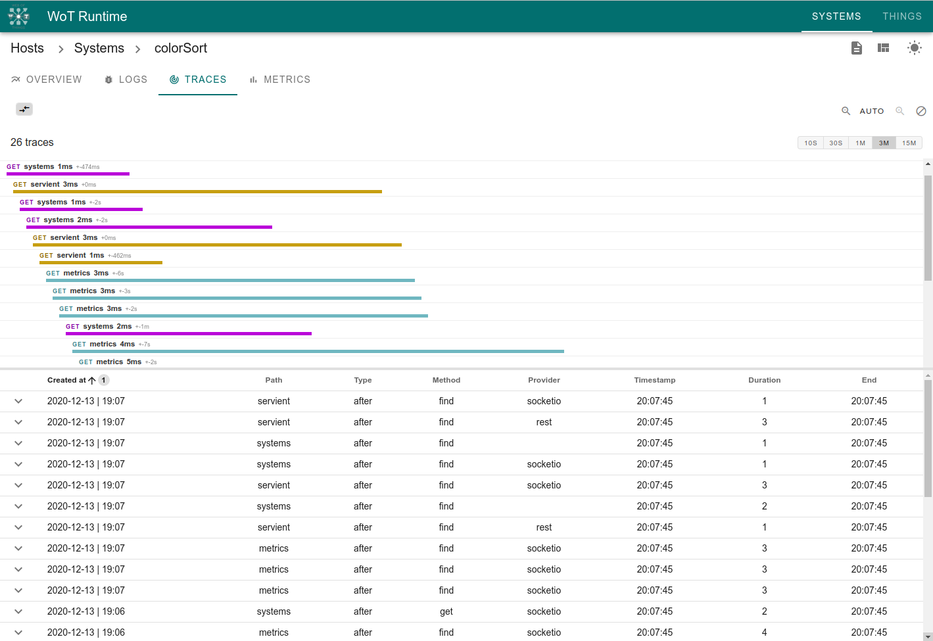
Approach WoT Runtime UI - Traces

Slide 50
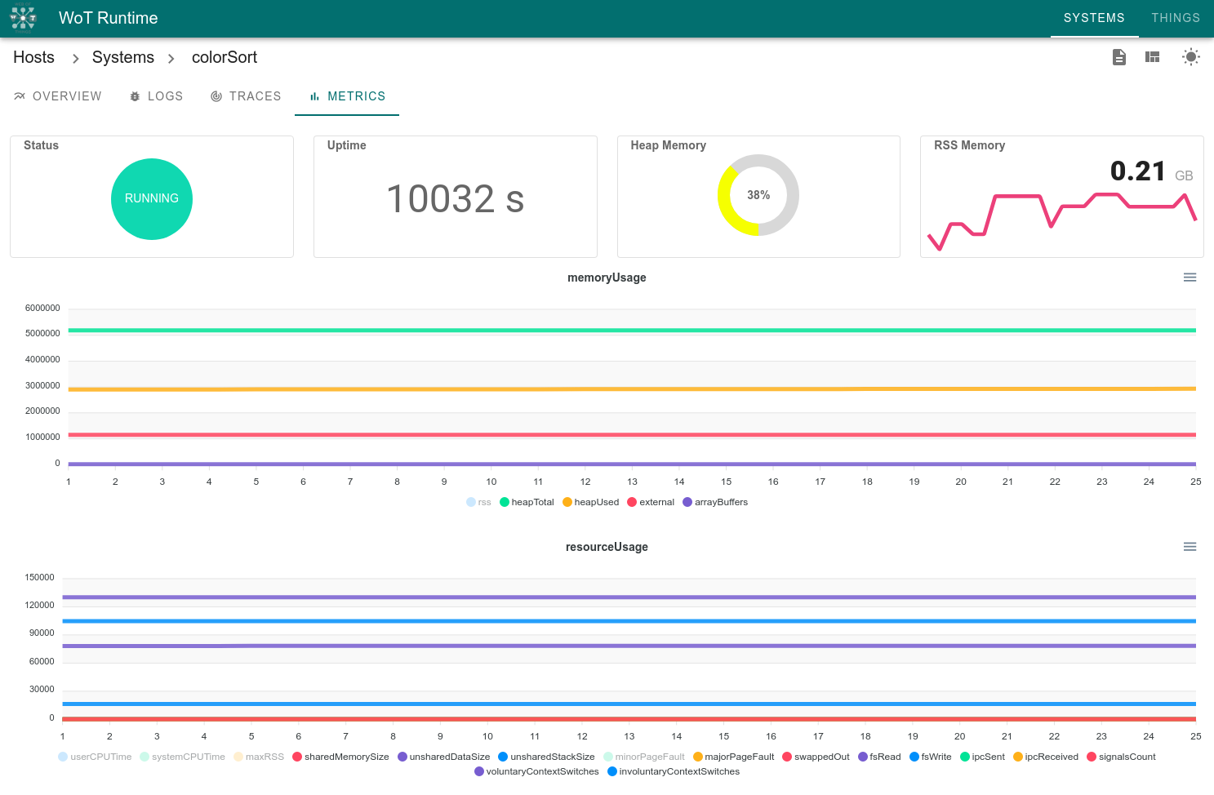
Approach WoT Runtime UI - Metrics

Slide 51
Introduction
Motivation
WoT Thing Description
WoT System Description
Problem Statement
Approach
Overview
Methodology
Execution Environment
Execution Control
Evaluation
Results
Conclusion

Slide 52
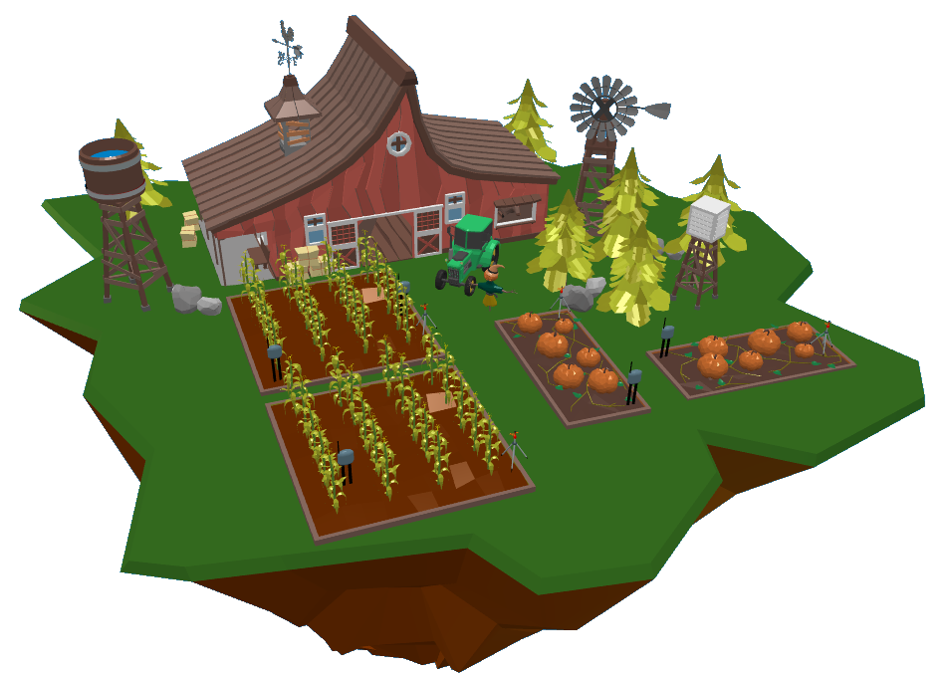
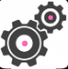
Evaluation Results
Smart Farm Simulation Use Case
System Runtime
Notes:
Introduction of the SRD to the WoT demonstrated positive results on the second evaluation use case: a smart farm simulation like the one seen above

Slide 53
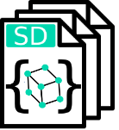
Evaluation Results
Smart Farm Simulation Use Case
A) Management of multiple SDs and TDs via API
System Runtime
Notes:
Through the WoT Runtime framework, management of multiple SDs and TDs is made possible

Slide 54

Evaluation Results
Smart Farm Simulation Use Case
B) Runtime monitoring via logs, metrics and traces
[warn] DeprecationWarning
[error] ReferenceError
[info] Started system 239...
[info] Created SRD for sy...
[error] NetworkError
A) Management of multiple SDs and TDs via API
System Runtime
Notes:
The WoT Runtime can be monitored using the 3 observability standards of logs, metrics, and traces

Slide 55

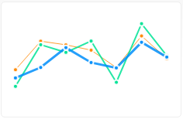

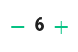
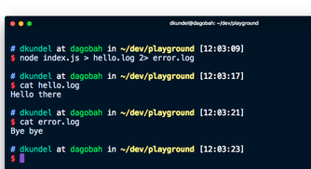

Evaluation Results
Smart Farm Simulation Use Case
C) Mashup monitoring and control via auto-generated GUI
B) Runtime monitoring via logs, metrics and traces
[warn] DeprecationWarning
[error] ReferenceError
[info] Started system 239...
[info] Created SRD for sy...
[error] NetworkError
A) Management of multiple SDs and TDs via API
System Runtime
Notes:
Similarly, mashup-specific monitoring is made possible, especially through the usage of the WoT Runtime UI module, which auto-generates GUIs for monitoring and control

Slide 56
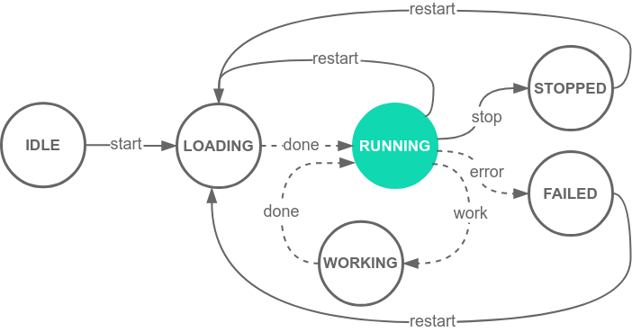
Evaluation Results
Smart Farm Simulation Use Case
C) Mashup monitoring and control via auto-generated GUI
B) Runtime monitoring via logs, metrics and traces
D) Safe and secure execution environment
[warn] DeprecationWarning
[error] ReferenceError
[info] Started system 239...
[info] Created SRD for sy...
[error] NetworkError
A) Management of multiple SDs and TDs via API
System Runtime
Notes:
Results demonstrates safety and security compliance of the execution Environment

Slide 57
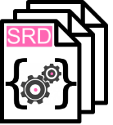
Evaluation Results
Smart Farm Simulation Use Case
C) Mashup monitoring and control via auto-generated GUI
B) Runtime monitoring via logs, metrics and traces
D) Safe and secure execution environment
[warn] DeprecationWarning
[error] ReferenceError
[info] Started system 239...
[info] Created SRD for sy...
[error] NetworkError
A) Management of multiple SDs and TDs via API
E) SRD for composing multi-layered architectures
consume
expose-
System Runtime
Notes:
Finally, the SRD of WoT Systems is consumable as if it were a Thing, to allow composing multi-layered WoT Architectures

Slide 58
Evaluation Results
Smart Farm Simulation Use Case
C) Mashup monitoring and control via auto-generated GUI
B) Runtime monitoring via logs, metrics and traces
D) Safe and secure execution environment
[warn] DeprecationWarning
[error] ReferenceError
[info] Started system 239...
[info] Created SRD for sy...
[error] NetworkError
A) Management of multiple SDs and TDs via API
E) SRD for composing multi-layered architectures
consume
expose-
System Runtime

Slide 59
Introduction
Motivation
WoT Thing Description
WoT System Description
Problem Statement
Approach
Overview
Methodology
Execution Environment
Execution Control
Evaluation
Results
Conclusion

Slide 60
Conclusion
In conclusion:
The WoT Runtime Framework introduces an additional WoT building block for:
remote deployment of SDs into safe execution Environments,
management of WoT System Runtimes,
and monitoring and control through the auto-generated SRD
Notes:
In conclusion

Slide 61
Conclusion
In conclusion:
The WoT Runtime Framework introduces an additional WoT building block for:
remote deployment of SDs into safe execution Environments,
management of WoT System Runtimes,
and monitoring and control through the auto-generated SRD
The SRD allows composing multi-layered WoT architecutes
Notes:
In conclusion

Slide 62
Conclusion
In conclusion:
The WoT Runtime Framework introduces an additional WoT building block for:
remote deployment of SDs into safe execution Environments,
management of WoT System Runtimes,
and monitoring and control through the auto-generated SRD
The SRD allows composing multi-layered WoT architecutes
The approach is evaluated in two use cases
An industrial automation scenario
and a smart farm simulation
demonstrating how the proposed solution works in practice
The WoT Runtime framework lays the basis for future in distributed WoT architectures
Notes:
In conclusion

Slide 63
Thank you for your attention
Notes:
In conclusion

